Slide 1
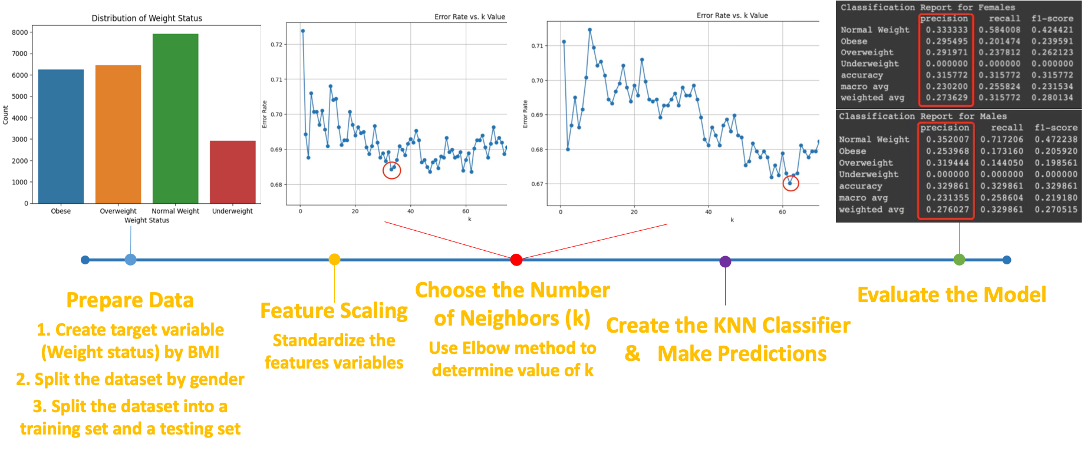

Slide 2
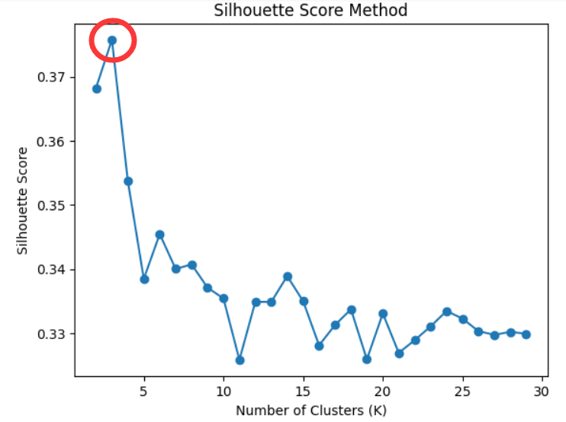
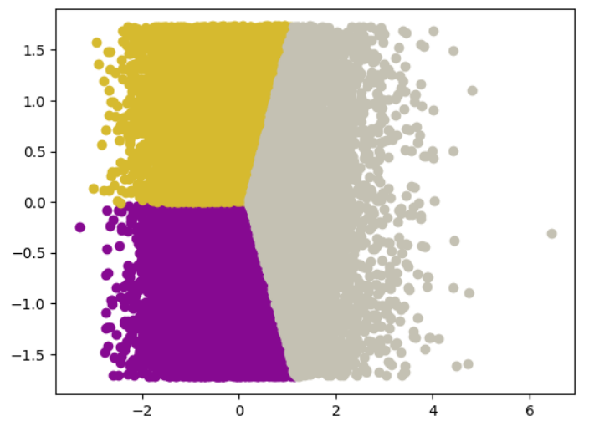

Slide 3
Conclusion on Key Findings
Over accuracy for general KNN model: 32%
After stratifying by gender, the KNN model on female vs male has an accuracy: 32% vs 33%
No obvious difference between the performance of KNN models among different gender groups;
but the KNN model on female group performs slightly better than male group on predicting obese and overweight groups, and slightly worse than male group on predicting the normal weight group.
K-Means clustering based on features BMI and Calorie Intake.
Limitations
The accuracy for predicting underweight group is 0 because they are underrepresented under large k.
The overall accuracy is lower than expected.

